Slide 1
Software Requirements Engineering
Lectures 2&3

Slide 2
Contents
Definition of Requirement
Levels of Requirements
2.1 Business Requirements
2.2 User Requirements
2.3 Functional Requirements
3. Other Types of Requirements
3.1 System Requirements
3.2 Business Rules (not a type of requirement but affects the requirements)
3.3 Non-Functional Requirements
3.4 Feature
3.5 Product vs Project Requirements

Slide 3
Contents
Example to demonstrate different types
Requirements Document
Different Roles in Requirements Engineering
Activities in Requirements Engineering Process
7.1 Requirements Elicitation
7.2 Requirements Analysis
7.3 Requirements Specification
7.4 Requirements Validation
7.5 Requirements Management

Slide 4
1. What is Requirement
Business Rule
Business Requirement
Contraints
Process Requirement
System Requirement
User requirement
User Story
Feature
Functional Requirement
Product
Requirement
Non-Functional Requirement

Slide 5
1. Definition of Requirement
Specific description of your client’s needs
The Institute of Electrical and Electronics Engineers (IEEE) defines a requirement as:
A condition or capability needed by a user to solve a problem or achieve an objective.
A condition or capability that must be met or possessed by a system or system component to satisfy a contract, standard, specification, or other formally imposed documents.
A documented representation of a condition or capability as in (1) or (2). (IEEE, 1990).

Slide 6
1. Definition of Requirement
A requirement is “anything that drives design choices” (Lawrence 1997).
The whole point of developing requirements is to make appropriate design choices that will meet the customer’s needs in the end.
A requirement is a property that a product must have to provide value to a stakeholder.
“Requirements are a specification of what should be implemented. They are descriptions of how the system should behave, or of a system property or attribute. They may be a constraint on the development process of the system.” (Ian Sommerville and Pete Sawyer, 1997)
This definition acknowledges the diverse types of information that collectively are referred to as “the requirements”

Slide 7
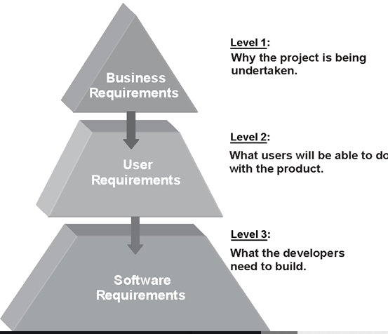
2. Levels of Requirements
Level 1
Why the product is being developed?
Level 2
What the users will be able to do with the product
Level 2
What the developer need to develop to meet the user requirements
Functional Requirements

Slide 8
2.1 Level 1 - Business Requirements
Business requirements describe why the organization is implementing the system—the business benefits the organization hopes to achieve.
The focus is on the business objectives of the organization or the customer who requests the system.
Suppose an airline wants to reduce airport counter staff costs by 25 percent.
Building a kiosk that passengers can use to check in for their flights at the airport.
Origin: Business requirements typically come from the funding sponsor for a project, the acquiring customer, the manager of the actual users, the marketing department, or a product visionary.
We record the business requirements in a vision and scope document

Slide 9
2.2 More Examples of Business Requirements
Increase Revenue and Sales:
Develop an e-commerce platform to expand the company's online presence and drive higher sales by reaching a wider customer base.
Improve Customer Experience:
Create a mobile app with intuitive navigation, real-time updates, and personalized recommendations to enhance user satisfaction and loyalty.
Enhance Operational Efficiency
Build a custom inventory management system to streamline stock tracking, reduce wastage, and optimize reorder processes.

Slide 10
2.2 More Examples of Business Requirements
Reduce Costs and Resource Usage:
Implement a software solution to automate routine administrative tasks, reducing manual labor and minimizing operational expenses.
Support Regulatory Compliance:
Develop a software tool that ensures accurate financial reporting and compliance with industry regulations to avoid penalties and legal issues.
Facilitate Decision-Making:
Create a business intelligence dashboard that consolidates data from various sources, enabling informed decision-making for strategic planning.

Slide 11
2.3 Level 2 - User Requirements
User requirements describe what the user will be able to do with the system.
Origin: Ideally, actual user representatives will provide this information.
Ways to represent user requirements include use cases, user stories and event-response tables.
An example of a use case is “Check in for a flight” using an airline’s website or a kiosk at the airport. Written as a user story, the same user requirement might read: “As a passenger, I want to check in for a flight so I can board my airplane.”
Most projects have multiple user classes, as well as other stakeholders whose needs also must be satisfied

Slide 12
2.2 Level 2 - User Requirements
Class Activity: Write User Requirements for an online store selling different household items.

Slide 13
2.3 Level 3 - Functional Requirements
Functional requirements specify the behaviors the product will exhibit under specific conditions.
They describe what the developers must implement to enable users to accomplish their tasks (user requirements), thereby satisfying the business requirements.
Functional requirements often are written in the form of the traditional “shall” statements:
“The Passenger shall be able to print boarding passes for all flight segments for which he has checked in”

Slide 14
2.3 Level 3 - Functional Requirements
The Business Analyst (BA) document functional requirements in a software requirements specification (SRS), which describes as fully as necessary the expected behavior of the software system.
“Business analyst” refers to the project role that has primary responsibility for leading requirements-related activities on a project.

